Slide 1
Tips on how to write a successful proposal
Themiya Nanayakkara
JWST MASTER CLASS MELBOURNE 2022

Slide 2
Tip #1 - START EARLY!
JWST is a complex observatory with complex instrumentation
Help us disseminate the message that the community needs to start working on proposals early to be ready last the submission deadline.s

Slide 3

Tip #2 - GET FAMILIAR WITH THE DOCUMENTATION!
JWST proposals are submitted via a single-stream process through the Astronomer's Proposal Tool, where all information about the proposed science and observations are provided up front at the time of submission.
Single stream proposal preparation is more complex than HST
Submitted proposals must include sufficient information to define scheduling constraints for all visits (where each visit is directed at a specific target). Astronomers will submit their observing requirements using a set of templates for specific instrument modes. These templates are available in the Astronomer's Proposal Tool (APT).
The submitted observing requirements include a full list of targets, specifications of the observations (instruments, filters, exposure times, dithers, observational sequence), and all user-requested scheduling constraints (including roll angle and other timing constraints). Complete APT files are required at submission so that APT can compute the direct overhead duration, which is defined by the sum of slews, the guide star and target acquisitions, mechanism motions, and small angle maneuvers, which are summed together to determine the total instrument overheads.
http://www.stsci.edu/jwst/science-planning
http://jwst-docs.stsci.edu
http://www.stsci.edu/jwst/science-planning
http://www.stsci.edu/jwst/science-planning

Slide 4
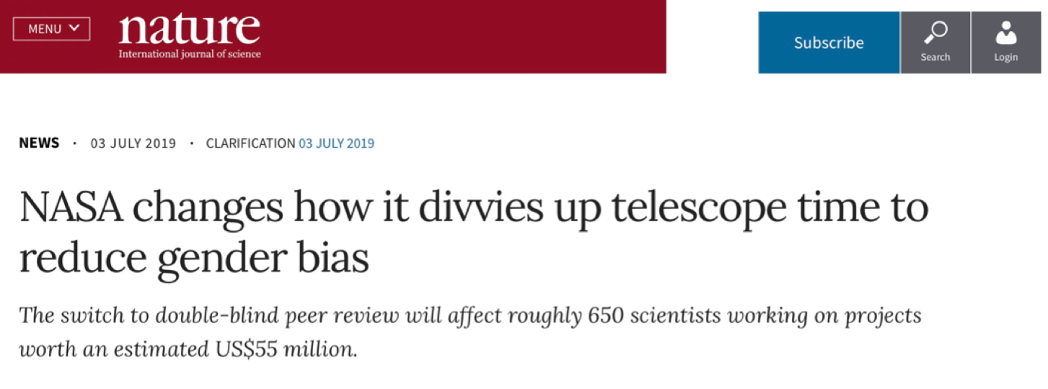
Proposal Submission - dual anonymous
STScI uses a dual anonymous proposal review for both JWST and HST
The identity of proposers are not known to reviewers in the process of scientific ranking.
This requires thought in crafting proposals (see presentation on “How o Write a Successful proposal”

Slide 5
Proposal Submission - dual anonymous
Proposers must craft their PDFs (scientific justification and description of observations) to be anonymous.
They must exclude names and affiliations of the proposing team, including in figures and references to personal websites.
They must not claim ownership of past work, e.g., “my successful HST program (GO-######)…” or “Our analysis shown in Doe et al. 2012…”
Rather, they should cite references in passive third person, e.g., “The HST program GO-##### did…”, or “Analysis shown by Doe et al. 2012…”. This includes references to proprietary data and software.
They must describe the work proposed, e.g., “We propose to do the following…” or “We will measure the effects of…”

Slide 6
Dual-anonymous guidelines
Proposals that have egregiously violated these rules are brought to the attention of the SPG and flagged for disqualification prior to the meeting.
Less serious cases (a stray “we” or “our”) are also pointed out. Panelists are encouraged attempt to ignore these less flagrant errors whenever possible, and keep focused on the scientific merits.
Cases that are too difficult to ignore (levelers could be important in making that decision), or not sufficiently anonymized, are commented on in the recommendations to the Director, and may be disqualified.
Panelists also provide specific feedback in their comments to proposers if a proposal was not sufficiently made anonymous.
TIP#3 - COMPLY WITH DUAL-ANONYMOUS GUIDELINES

Slide 7
Proposal Review
Proposals are evaluated solely on the scientific merit of what’s proposed,
Panelists are instructed not to spend any time attempting to identify the PI or the team.
They are instructed to discuss the science and not the people.
Levelers are present in each room to help insure guidelines are respected.
Language IS very important. Utilize the appropriately neutral pronouns (e.g.,“what they propose”, or “the team has evaluated data from a HST Cycle 25 program”).
TIP#4 - MAKE IT EASY FOR THE REVIEWERS TO REVIEW

Slide 8
Proposal Review Process
The time allocation committee (TAC) review will span two weeks.
Week 1: “Galactic” topics; Week 2: “Extragalactic”
~10 topical panels will meet each week, Monday through mid-day Wednesday, to review GO small and medium, and AR proposals.
Panel chairs will review Large, Treasury, and AR Legacy proposals mid-Wednesday through Friday
Recommendations will be approved at the Director’s review, approximately 1 to 2 weeks after the Extragalactic TAC. ESA Senior Rep. present at the Director’s review.
Full program to be announced afterwards.
All proposals will require a technical review..

Slide 9
Proposal Review Process
The topic panels are broad in expertise.
Small and medium proposal need to be written with a “broad” appeal.
Large and Treasury are reviewed by the TAC, which is a multi-discipline committee (Solar System to Cosmology).
It is especially important to convey the significance of the science case to TAC members who might be experts in a different topic.
TIP#5 - WRITE YOUR SCIENCE CASE FOR ASTRONOMERS,
BUT NOT NECESSARILY EXPERTS IN YOUR FIELD

Slide 10
Extra Notes
Cycle 2 proposal deadline: January 27th @ 8 PM EST = January 28th @ 12 PM AEDT.
Proposals have total page limits but there are no limits on specific sections (i.e., Scientific Justification and Technical Justification sections are not limited in how long they can be within the total, but proposers should aim for a balance).
A new version of the GTVT/MTVT (v0.3.0) was recently released. This release includes an updated JWST ephemeris, so updating this tool (if you have already installed it) would be a good idea to ensure more accurate visibility windows.
JIST has not yet been updated based on commissioning results (waiting for release of ETC 2.0).
The "awesimsoss" tool has been subsumed into MIRAGE and is no longer standalone.
MIRISim can still be downloaded but is no longer under active development. Support for this tool is extremely reduced.
The "duty cycle" definition is incorrect. It should be (saturation_time * number_integrations_per_exposure)/exposure_time.
Simultaneous NIRCam coronagraphic imaging with the short- and long-wavelength channels is available in Cycle 2. APT and ETC will provide support for this updated mode.
A new constraint, called the "micrometeoroid avoidance zone (MAZ)," will limit scheduling windows starting in Cycle 2. Basically, the number of observations in the direction of JWST's motion will be limited to reduce mirror degradation by micrometeoroid impacts. A new JDOX page will be published next week giving more details.

Slide 11
and when in doubt, ask the HelpDesk:
https://jwsthelp.stsci.edu/
THANK YOU!

